Slide 1





Musify
Summer of Code ‘22
Melody generation using RNN LSTM
Mohit Punasiya
213170006

Slide 2
Idea
Using RNN-LSTM trained Model to generate music with data extracted from kaggle

Slide 3
Steps Involved
Importing libraries
Reading and parsing the MIDI Files
EDA and DATA preparation
Building the Model, training the model
Hyperparameter tweaking
& Listen to AI generated music

Slide 4
Libraries Used
Music21
Keras
TensorFlow
Numpy
tqdm

Slide 5
Work Flow
Week 1 Brushing up basic python concepts
Week 2 Started with reading relevant articles on music generation
Week 3 Neural network and relevant concepts of deep learning
Week 4 Started Learning Tensor flow
Week 5 Tinkering with tensor flow and RNN LSTM
Week 6 Implementation part started
Week 7 model training and building
Week 8 Submission documentation and repo

Slide 6

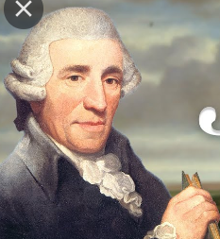
Comparison
AI Generated Music
Hayden Composed Original Music

Slide 7
Thank You!

